Slide 1
Deep Learning 调研
畅星兆，2019.09.11

Slide 2
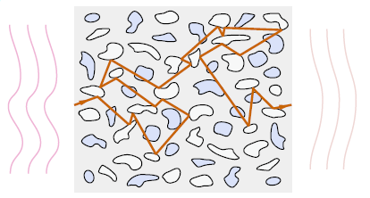
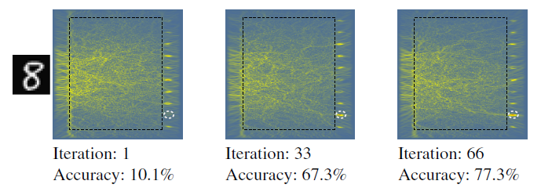
研究情况
Yichen Shen (Lightelligence Inc.)
1. Gated orthogonal recurrent units: On learning to forget
2. Nanophotonic particle simulation and inverse design using artificial neural networks
3. Tunable Efficient Unitary Neural Networks (EUNN) and their application to RNN
Zongfu Yu (Wisconsin-Madison)
有图
深度学习指导光波导设计
Zongfu Yu et al., “Nanophotonic media for artificial neural inference”, Photonics Research, 2019.

Slide 3
Nicholas C. (Lightelligence Inc.)
Linear programmable nanophotonic processors
Shanhui Fan (Stanford)
Training of photonic neural networks through in situ backpropagation and gradient measurement
Wave Physics as an Analog Recurrent Neural Network(使用声波)

Slide 4
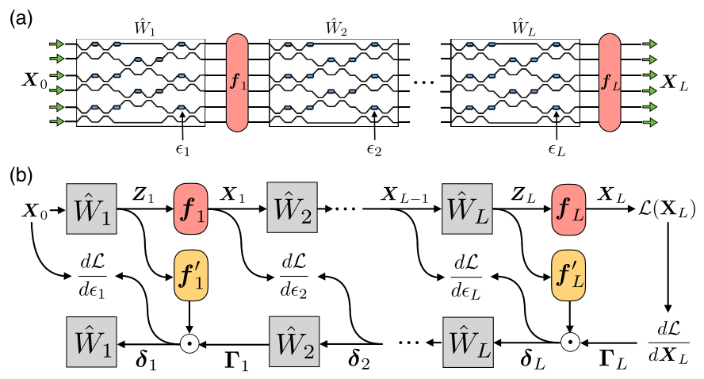
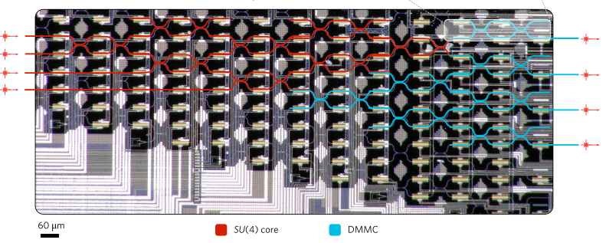
In situ backpropagation and gradient measurement
in situ intensity measurements.
requiring an integrated intensity detection scheme
physically implementing adjoint variable method
improved version of
Shen Yichen etal., Deep learning with coherent nanophotonic circuits, Nature Photonics, 2017
Schematic of the ANN architecture.
Illustration of operation and gradient computation in an ANN.
Shanhui Fan et al., “Training of photonic neural networks through in situ backpropagation and gradient measurement”, Frontiers in Optics/ Laser Science, 2018.

Slide 5
ANN的实现
input vector ---> output vector via matrices
tuning matrix elements (weights) for minimized cost function
tuning is implemented by “backpropagation algorithm”
utilizing the chain rule from the output layer to the input layer
对原文献的评价：
the training of the phase-shifter settings for this system was performed using a model implemented on a standard computer, which does not take into account experimental errors, and furthermore loses all the potential advantages in time and energy of the photonic implementation.
改进：
The only additional component that is required is a means to measure the light intensity in the vicinity of each of the tunable phase shifters.

Slide 6
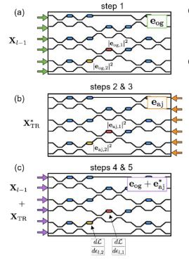
步骤
Send in the original field amplitude and measure and store the intensities at each phase shifter.
Send delta into the output ports and measure and store the intensities at each phase shifter.
Compute the time-reversed adjoint input field amplitudes.
Interfere the original and the time-reversed adjoint fields in the device, measuring again the resulting intensities at each shifter.
Subtract the constant intensity terms from steps 1 and 2 and multiply by k square to recover the gradient.
Shanhui Fan et al., “Training of photonic neural networks through in situ backpropagation and gradient measurement”, Frontiers in Optics/ Laser Science, 2018.

Slide 7
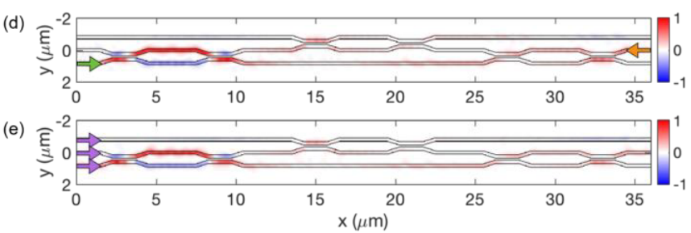
Restriction
Assuming linear, lossless, reciprocal, feed-forward propagation inside the OIU.
Mode-dependent loss limits the ability to accurately reconstruct the time-reversed adjoint field.
40% of the light is lost due to back-scattering and radiation losses for 3 * 3 operation. (shown below)
Shanhui Fan et al., “In-situ Backpropagation in Photonic Neural Networks”, Frontiers in Optics/ Laser Science, 2018.

Slide 8
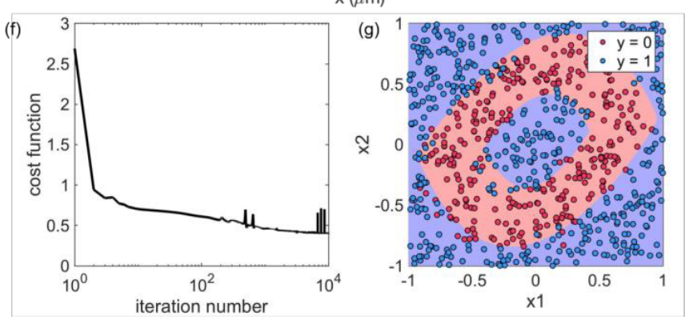
Results
91% precision
Shanhui Fan et al., “In-situ Backpropagation in Photonic Neural Networks”, Frontiers in Optics/ Laser Science, 2018.

Slide 9
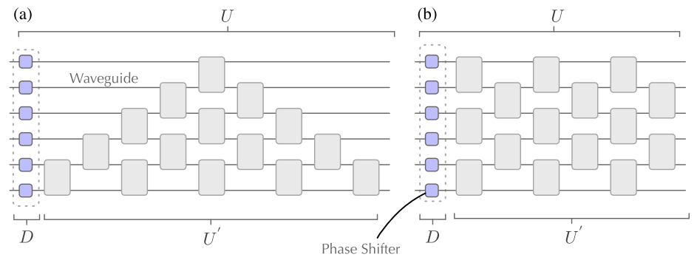
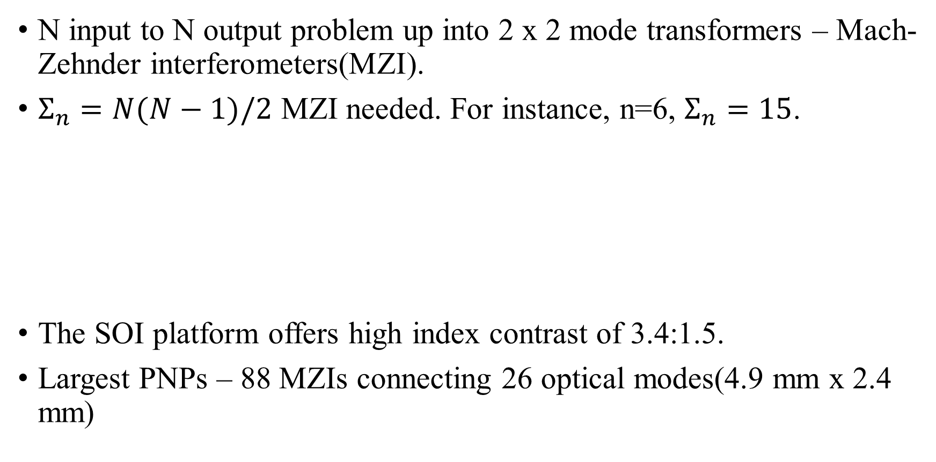
Linear programmable nanophotonic processors
(Nicholas C. let al., “Linear programmable nanophotonic processors”, Optica, 2018.)
N input to N output problem up into 2 x 2 mode transformers – Mach-Zehnder interferometers(MZI).
$Σ_{n}=N(N−1)/2$ MZI needed. For instance, n=6, $Σ_{n}=15$.
The SOI platform offers high index contrast of 3.4:1.5.
Largest PNPs – 88 MZIs connecting 26 optical modes(4.9 mm x 2.4 mm)
(a) reck(1994) (b)clement(2016)

Slide 10
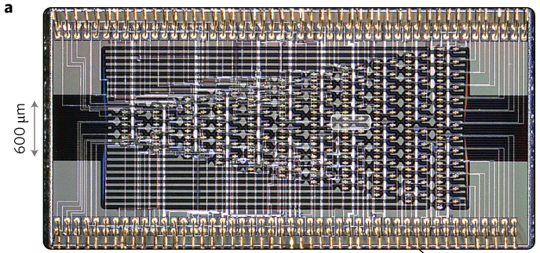
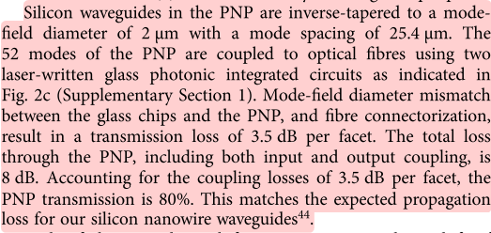
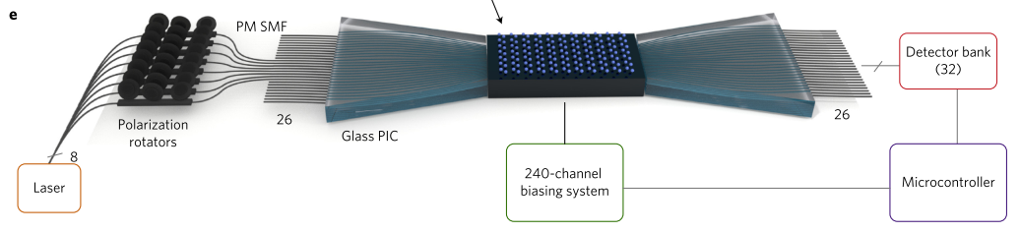
Processor composed of 88 MZIs, 26 input modes, 26 output modes and 176 phase shifters
(Nicholas C. let al., “Linear programmable nanophotonic processors”, Optica, 2018.)

